Slide 1
News Article Categorization Using Naïve Bayes and TF-IDF
Name: Riya Kaitharam Varghese
Reg No: 2363055

Slide 2
Introduction: The Challenge of Organizing News Content
In today's fast-paced digital landscape, an overwhelming volume of news articles is published daily, making manual organization impractical and inefficient. As of 2025, estimates suggest over 5 million news articles are published worldwide every day.
This necessitates automated classification to enable faster, scalable content organization. Such systems are crucial for personalized news delivery, helping users navigate the vast information space and find relevant content instantly.

Slide 3
Problem Statement: Why Categorize News Articles?
Accurate and real-time news categorization is paramount for improving user experience and analytics in the digital age. News content covers an immense diversity of topics, ranging from politics and health to technology and religion.
High Volume
Overlapping Vocabulary
Evolving Language
The sheer quantity of daily news makes manual tagging impossible, requiring automated solutions.
Many topics share similar terms, posing a challenge for precise classification algorithms.
News language constantly changes with current events, demanding adaptive and robust classification models.

Slide 4


Methodology Overview: Combining Naïve Bayes with TF-IDF
To address the complexities of news article categorization, we employ a robust methodology that leverages the strengths of two powerful techniques:
Naïve Bayes Classifier
TF-IDF Vectorization
A probabilistic classifier that assumes feature independence, making it computationally efficient and highly effective for text classification tasks.
Transforms raw text into weighted numerical features, reflecting the importance of words within an article relative to the entire dataset.
Together, these methods enable efficient and accurate topic prediction from raw textual data, forming the backbone of our categorization system.

Slide 5
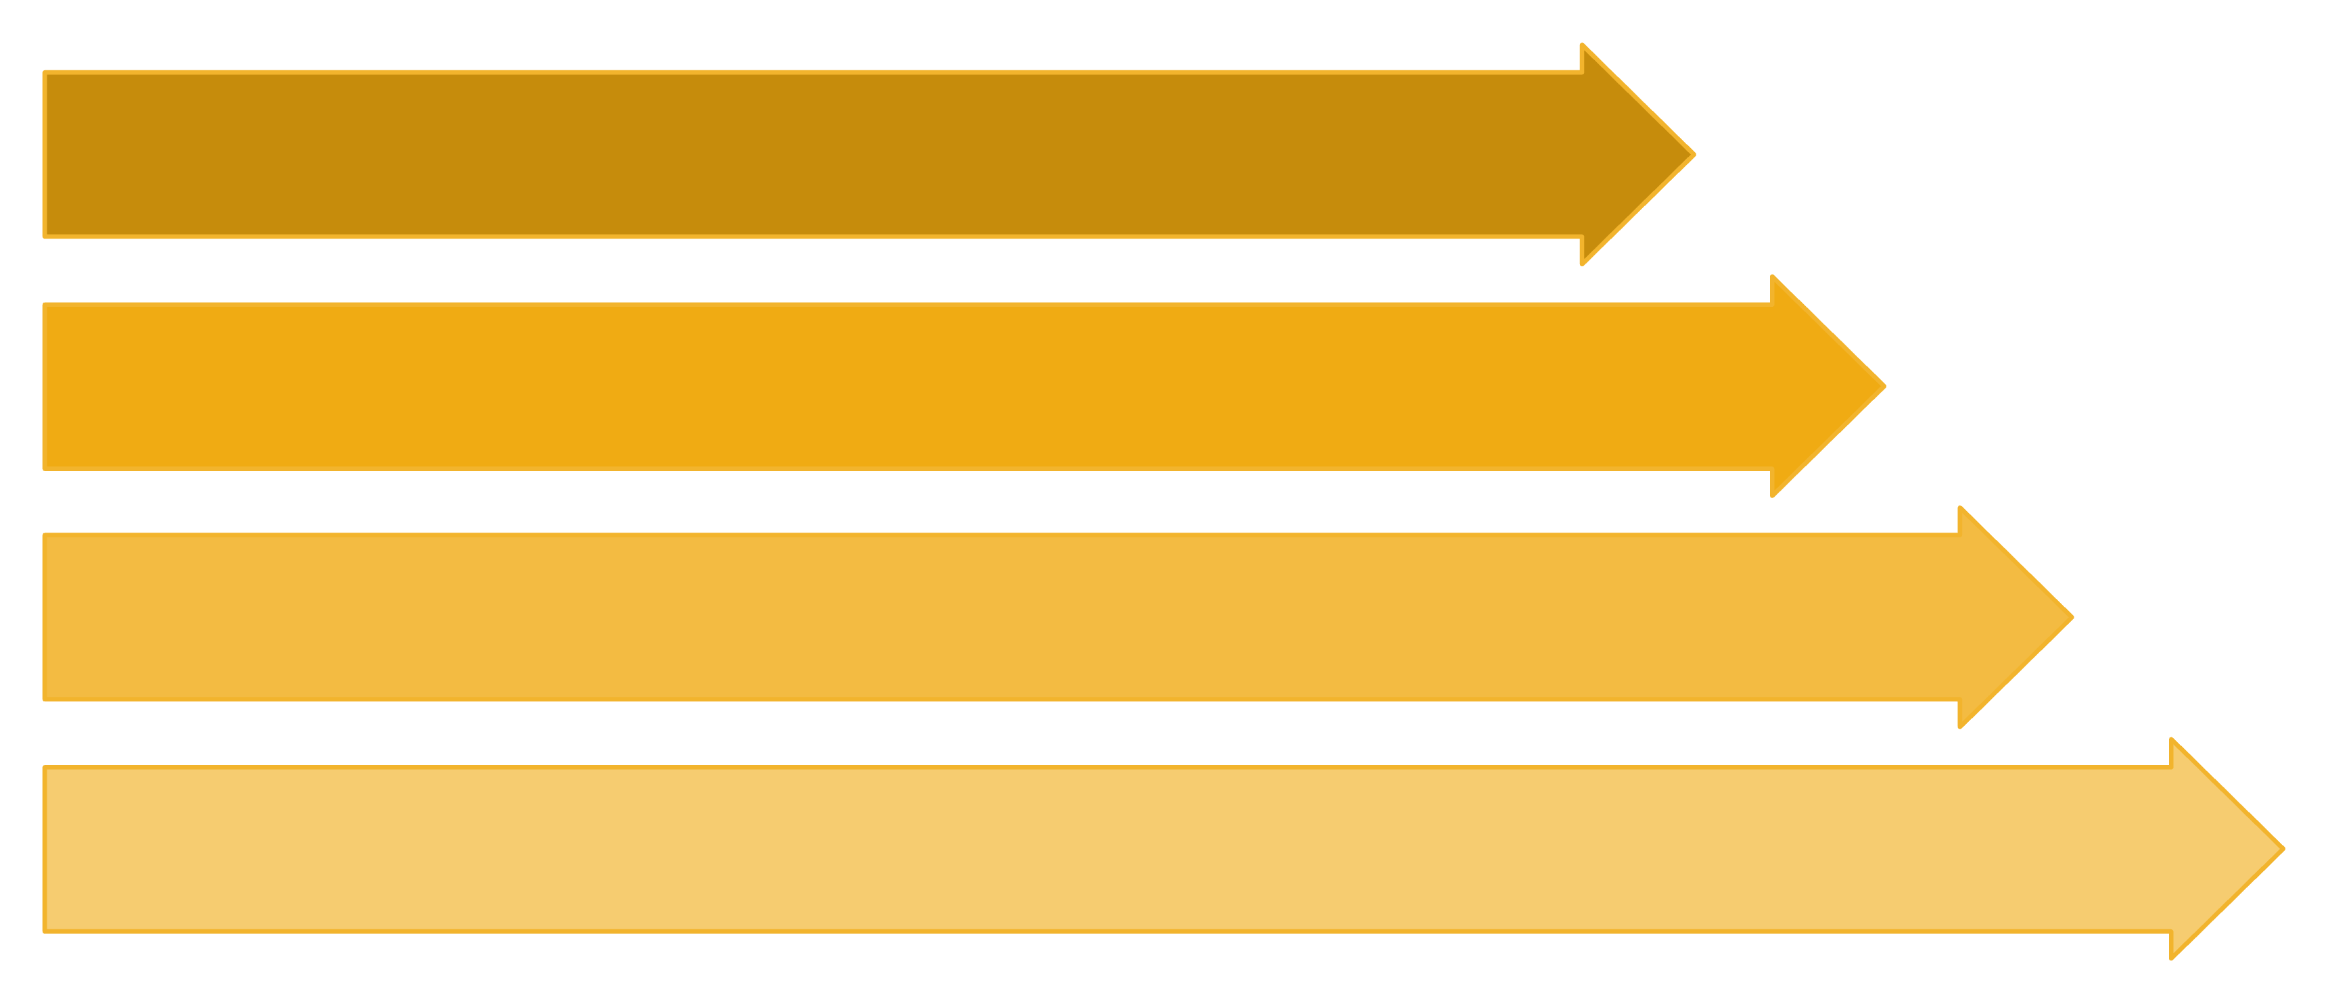
Flow Diagram: News Article Categorization Pipeline
Raw News
Preprocessing
TF-IDF
Naïve Bayes
This pipeline illustrates the systematic transformation of raw news text into categorized output, ensuring a streamlined and effective classification process.

Slide 6
Dataset Creation
A high-quality, representative dataset is fundamental for training effective machine learning models. We meticulously curated our training set to ensure robustness and minimize bias.
Diverse Collection
Defined Categories
Collected around 40–60 news snippets from online sources and manually created samples to ensure coverage across categories.
Articles were assigned to four core categories: Politics, Sports, Entertainment, and Technology.
Balanced Distribution
Rigorous Cleaning
Ensured approximately 10–15 articles per category to maintain balance and avoid bias towards any single topic.
Data was cleaned by removing duplicates and converting all text to a consistent format (lowercasing, stopword removal, etc.).

Slide 7





Text Preprocessing and Feature Extraction
Before classification, raw text must be transformed into a format suitable for machine learning algorithms. This involves a series of critical preprocessing steps.
Raw Text Input
Unprocessed news articles.
Tokenization
Splitting sentences and paragraphs into individual words or tokens.
Stopword Removal
Eliminating common, non-informative words (e.g., "the," "is," "and") to reduce noise.
TF-IDF Vectorization
Converting cleaned text into numerical feature vectors, quantifying word importance.
Sparse Matrix
Resulting representation, highlighting relevant word frequencies for each article.
This process yields a sparse matrix, which efficiently represents the unique word importance within each article, ready for classification.

Slide 8
Naïve Bayes Classifier: How It Works
The Naïve Bayes classifier operates on the principle of calculating the probability of an article belonging to a specific category based on its word features.
It simplifies calculations by assuming independence between words, a "naïve" assumption that surprisingly yields strong performance on high-dimensional text data.
Its core strength lies in its speed for both training and prediction, making it highly suitable for real-time applications in dynamic news environments.
This efficiency allows for rapid classification of incoming articles, supporting timely content delivery.

Slide 9

Conclusion
The combination of Naïve Bayes and TF-IDF offers an efficient and resource-friendly solution for the task of news article categorization. Even with a relatively small and balanced dataset across categories such as Politics, Sports, Entertainment, and Technology, the approach demonstrates reliable performance. This project highlights how lightweight NLP techniques can be effectively applied to real-world text classification problems without the need for complex models. Furthermore, the methodology can be easily scaled to larger datasets and extended to additional domains, making it a practical foundation for future improvements in automated news categorization.

